Slide 1
Mineral Amendment Analysis
Mineral Amendment Data Sharing:
The purpose of this database is to make mineral amendment analysis information available to all growers around the world.
Sharing the composition of alternative, low cost, sustainable resources used to feed the soil and plants with people is important.
All data will be published for free at https://www.nigel-palmer.com/data and updated periodically.
Another reference for mineral constituencies in plants is Dr. James Duke’s Phytochemical and Ethnobotanical database: https://phytochem.nal.usda.gov/phytochem/search
Special thanks to Logan Labs for participating in this most important project.
Thank you for your contribution

Slide 2
Mineral Amendment Submission to Logan Labs
Payment and shipment of mineral amendment:
The Logan Labs analysis fee is $38.00 per sample. This fee may be paid through Pay Pal at nigel-palmer.com/shop Note that this is the same fee as working directly with Logan Labs
Print and fill out the Logan Labs submission worksheet (next page). Use the Pay Pal Invoice number as the tracking number on this form.
For international submissions contact Logan Labs at office@loganlabs.com to get customs authorization document. Logan Labs will contact the authorities, submit request and send you the needed document that will enable shipping the amendment across international lines.
Thank you for your contribution

Slide 3
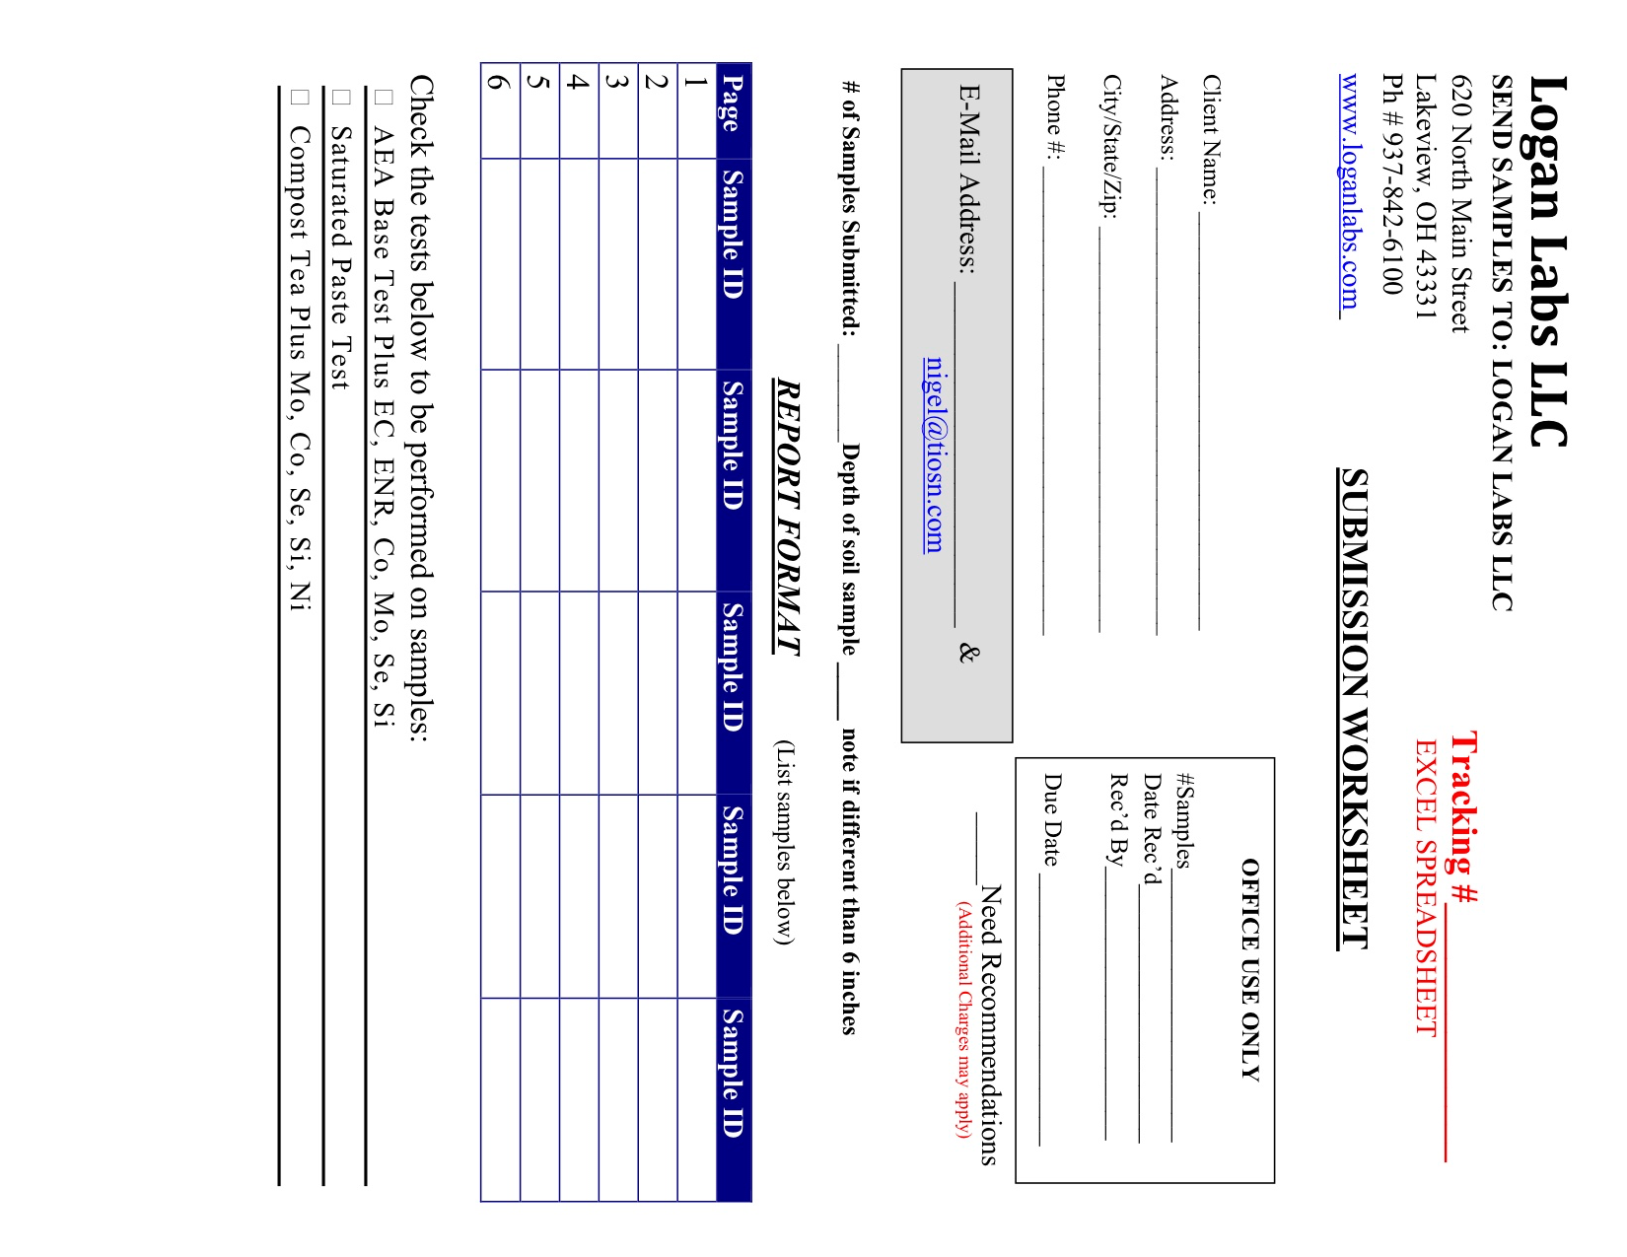
Please use this form to send actual sample to Logan Labs at the address at the top of the page
Use Pay Pal invoice number as tracking number
X

Slide 4
Mineral Amendment Submission to Logan Labs
Prepare Amendment(s) for shipment as follows:
POUR about 50 mL (1.5 ounce) of the amendment for analysis into a clean container and package for shipment.
Pack sample in box with Logan Lab submission worksheet (include pay pal invoice in tracking number box) and send to Logan Labs at the address on the form. If international be sure to include the customs information received from Logan Labs.
Logan Labs will contact me when received and will send analysis results to both of us when completed.
All analysis results will be published on https://www.nigel-palmer.com/data and available to all to view for free
Thank you for your contribution

Slide 5
Additional Mineral Amendment Information
Detailed Mineral Amendment Information:
Please provide information describing each mineral amendment to be included in the data base by copying and completing this spreadsheet.
Send a copy of the completed spreadsheet to nigel@tiosn.com
Contact me with any questions you may have nigel@tiosn.com
Date Made | Submitted by | Where in the World Made | Amendment Recipe | Material Description | Material Part(s) | Details | Process Times | Comments
Jan 29 2021 | Nigel Palmer | USA, CT | simmered extraction | garlic | bulbs | ratio 1 pound plant, 1 gallon water | simmer on stove for ~7 hours | surplus garlic from last year
March 12 2021 | Nigel Palmer | USA, CT | vinegar extraction | chicken egg shell | chicken egg shell | 10% egg shells 90% organic apple cider vinegar | time not recorded | egg shells from chickens
Jan 29 2021 | Nigel Palmer | USA, CT | fermented plant juice | sassafras | leaf | 0.6 pounds sassafras, 0.8 pounds organic brown sugar | 14 days | leaves harvested in September
Your Entry
Your Entry
Your Entry
Your Entry
Thank you for your contribution

